Slide 1
AMAZONE SALE REPORT
PROJECT MENTOR:
PROF.ARNAB CHAKRABORTY
Team Members:
Ayan Kundu
Neloofer Yashmeen
Moupiya Das

Slide 2
Contents
INTRODUCTION
DATASET OVERVIEW
Methodology
Data Preprocessing - Part 1
Data Preprocessing - Part 2
Exploratory Data Analysis
Model Implementations
K-Means Clustering
KNN Model
Random Forest Model
Linear Regression Model
Model Comparison
Conclusions
Future Improvements
Acknowledgments

Slide 3
Introduction
The Amazon Sales Analysis project aims to utilize machine learning techniques to uncover patterns and trends within sales data. By analyzing attributes such as order details, categories, and sales channels, the objective is to identify actionable insights that can help improve inventory management and forecast future sales trends effectively.
Scope:
The insights from this analysis can aid businesses in understanding customer preferences, optimizing stock levels, and enhancing the efficiency of sales strategies. Moreover, the machine learning models developed can be extended to larger datasets for broader applications in e-commerce analytics.

Slide 4
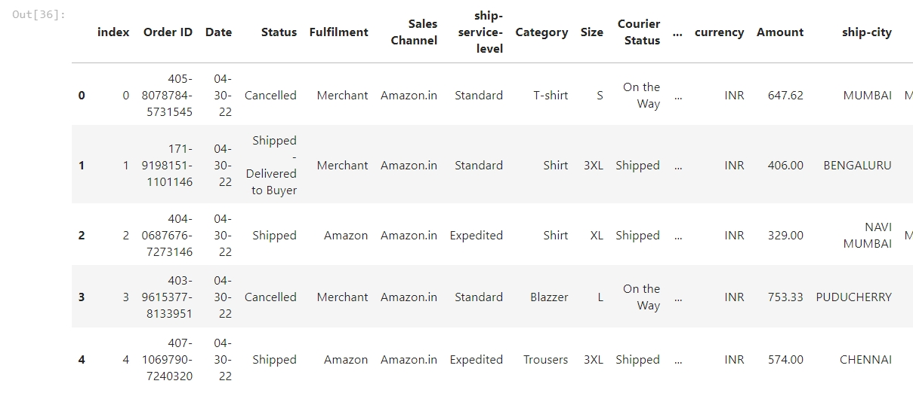
Dataset Overview
The description of the data with type and description of each Attribute is given/shown in the table

Slide 5
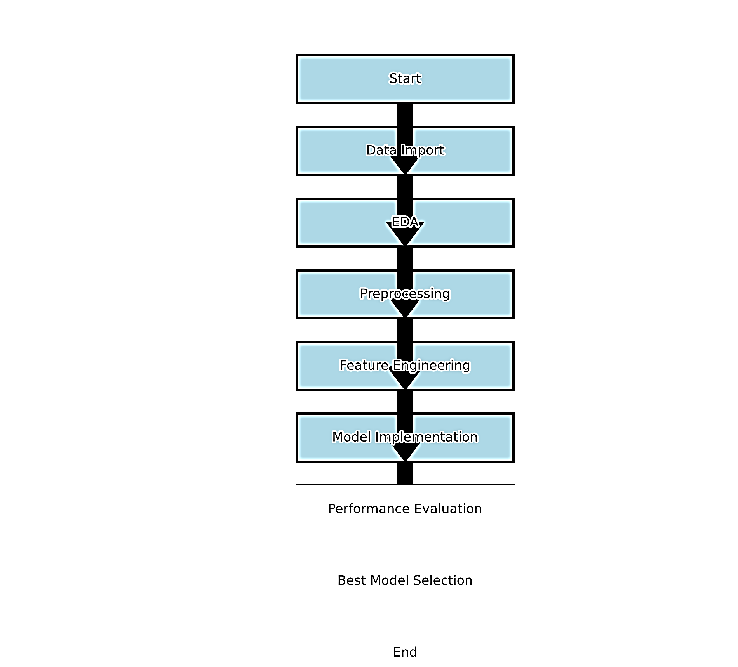
Methodology

Slide 6
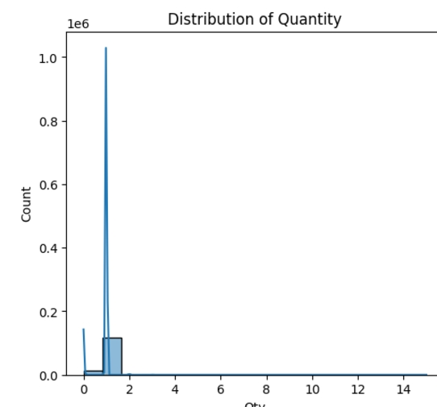
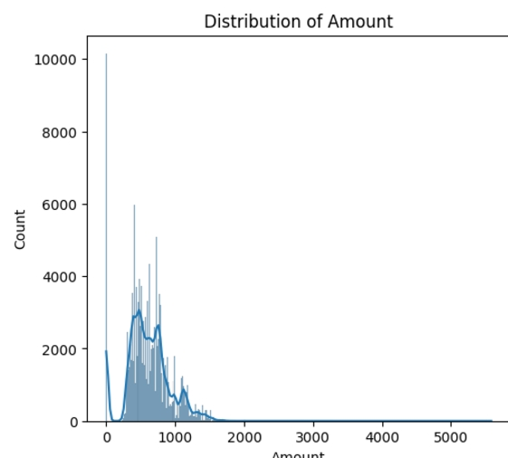
Data Preprocessing - Part 1

Slide 7
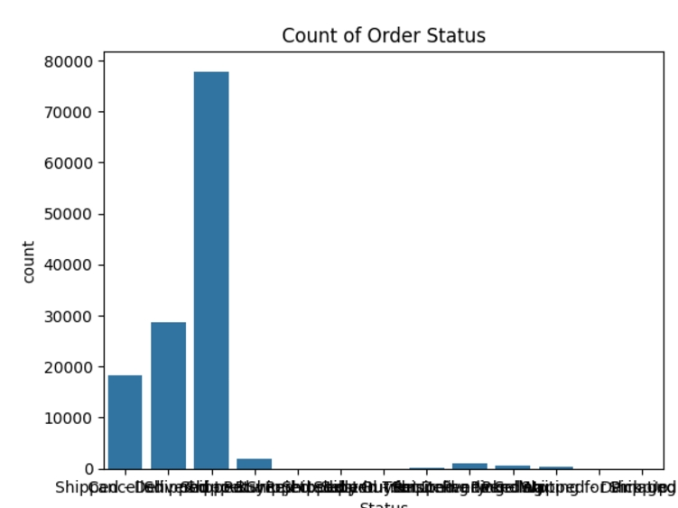
Data Preprocessing - Part 2

Slide 8
Exploratory Data Analysis
Seasonal Trends:
Sales peak during holidays and promotional events.
Category Demand:
- High sales in Electronics, Home Appliances, and Fashion.
Regional Patterns:
Urban areas lead in sales volume; rural areas show steady demand for essentials.
Implication:
Guides inventory and marketing strategies.

Slide 9
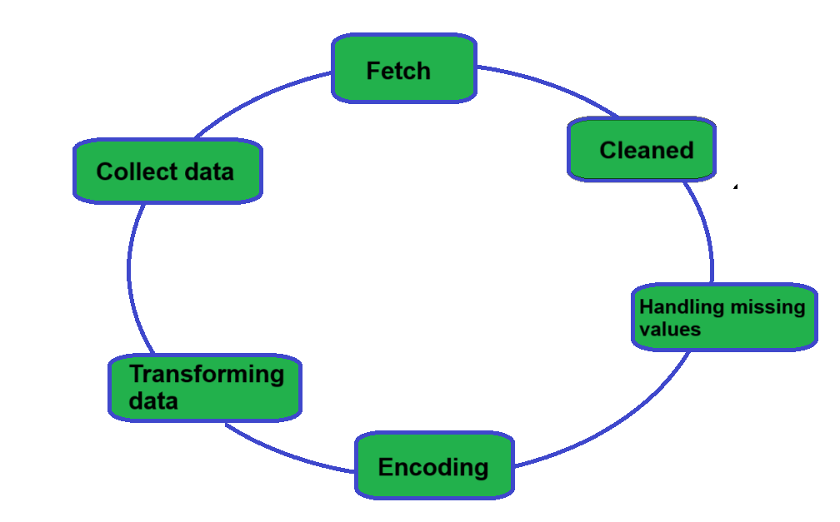
Model Implementations
K-Means Clustering
K-Nearest Neighbour
Random Forest Classifier
Logistic Regression
Linear Regression

Slide 10
K-Means Clustering
K means clustering, assigns data points to one of the K clusters depending on their distance from the center of the clusters. It starts by randomly assigning the clusters centroid in the space. Then each data point assign to one of the cluster based on its distance from centroid of the cluster. After assigning each point to one of the cluster, new cluster centroids are assigned. This process runs iteratively until it finds good cluster.
In the analysis we assume that number of cluster is given in advanced and we have to put points in one of the group.

Slide 11
KNN Model
A k-nearest-neighbor algorithm, often abbreviated k-nn, is an approach to data classification that estimates how likely a data point is to be a member of one group or the other depending on what group the data points nearest to it are in.
The k-nearest-neighbor is an example of a "lazy learner" algorithm, meaning that it does not build a model using the training set until a query of the data set is performed.

Slide 12
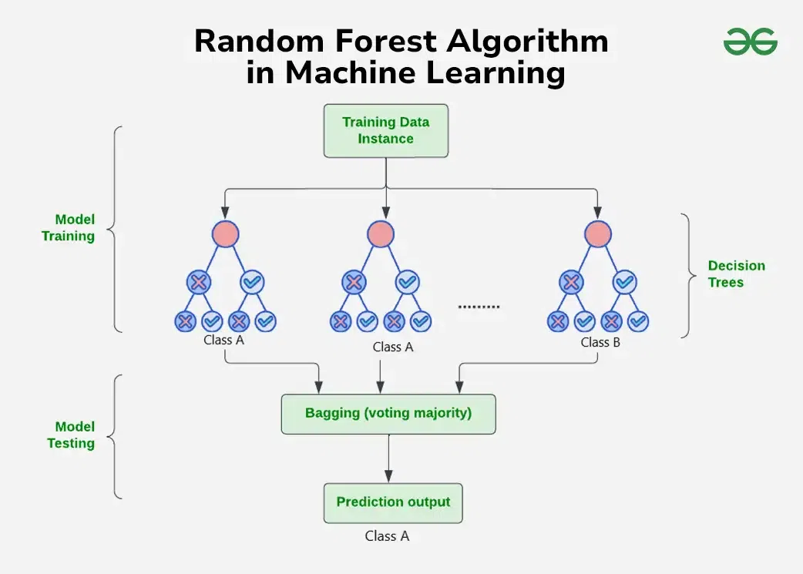
Random Forest Model
The Random Forest is an ensemble learning technique used for both classification and regression tasks. It constructs multiple decision trees during training and merges their outputs for more robust and accurate predictions. Each tree is trained on a subset of the data (using a technique called bagging), and the final output is determined by a majority vote (for classification) or the average (for regression).

Slide 13
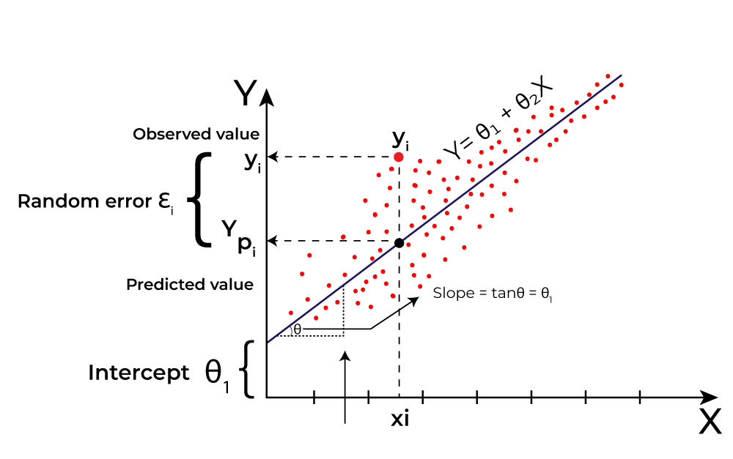
Linear Regression Model
Linear regression is a type of supervised machine learning algorithm that computes the linear relationship between the dependent variable and one or more independent features by fitting a linear equation to observed data.
When there is only one independent feature, it is known as Simple Linear Regression, and when there are more than one feature, it is known as Multiple Linear Regression.

Slide 14
Model Comparison
Random Forest: Highest accuracy for classification tasks; ideal for complex
relationships. Evaluated with accuracy and F1-score.
Linear Regression: Good for trend analysis and continuous predictions.
Assessed using MSE and R-squared.
K-Means Clustering: Best for uncovering patterns in unlabeled data.
Measured by silhouette score for cluster quality

Slide 15
Conclusions
Popular categories drive most sales.
Regional trends influence demand.
Random Forest provided the best predictions.

Slide 16
THANK YOU
Asansol Engineering College
Ayan Kundu(bipad12taran@gmail.com)
Neloofer Yashmeen(neloofaryashmeen.it.aec@gmail.com)
Moupiya Das(moupiyadas33@gmail.com)

Slide 17
Future Improvements
1. Use larger datasets for better training.
2. Include additional features like customer demographics.
3. Optimize models for real-time predictions.

